Slide 1
COVID-19 Vaccine Data
Journey Mendoza
Anthony Gonzalez
Kevin Danao
Jonathan Diaz

Slide 2
Presentation Content
Our project idea
Dataset
Flowchart
Pig script
Bar and Pie Charts
Notes:
-Anthony

Slide 3
What our Project is About
We gathered COVID-19 vaccine data on catalog.data.gov. In the dataset, it included a list of counties and states throughout the United States with information such as the hesitant rate and percentage of adults that are fully vaccinated. As a group, we decided to compare and contrast the average percentage of people hesitant versus the percent of adults that are fully vaccinated from five states in the West coast: California, Nevada, Arizona, Oregon, and Washington.
Notes:
-Anthony

Slide 4
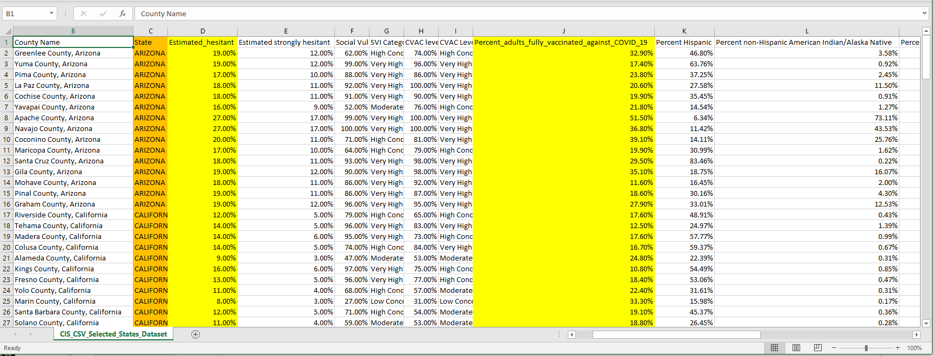
Dataset
https://catalog.data.gov/dataset/vaccine-hesitancy-for-covid-19-county-and-local-estimates-ed70f
Notes:
-Journey

Slide 5
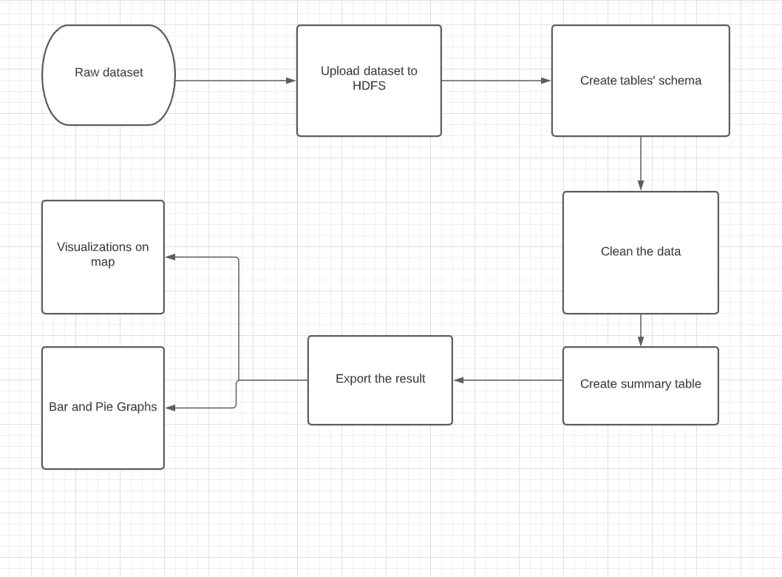
Implementation Flowchart
Notes:
-Journey

Slide 6
Pig Script For Order By
Assume dataset is loaded in the Hadoop FS, create a Pig script using (vi) to order our table in ascending/descending order.
ssh jdiaz231@220.116.230.21
vi hesitancy_pig_script.pig
hesitancy_dirty = LOAD '/user/jdiaz231/project1/CIS_CSV_Selected_States_Dataset.csv' using PigStorage(',');
hesitancy_clean = FOREACH hesitancy_dirty generate (chararray) $1 as County, (chararray) $2 as State, (double) $3 as EstimatedHesitancy, (double) $4 as StrongHesitancy;
StateHesitancy_Descending = ORDER hesitancy_clean BY EstimatedHesitancy DESC;
DUMP StateHesitancy_Descending LIMIT 5;
StateHesitancy_Ascending = ORDER hesitancy_clean BY EstimatedHesitancy ASC;
DUMP StateHesitancy_Ascending LIMIT 5;
Notes:
-Jonathan

Slide 7
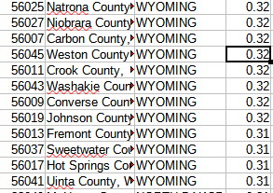
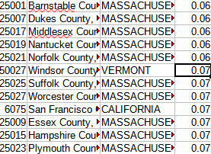
Ideally the result would be similar to sorting in Excel
DUMP StateHesitancy_Descending DUMP StateHesitancy_Ascending
Notes:
-Jonathan

Slide 8
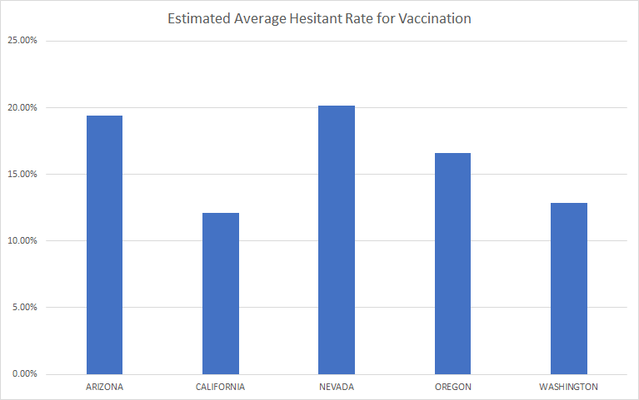
Bar Chart
Notes:
-Kevin

Slide 9
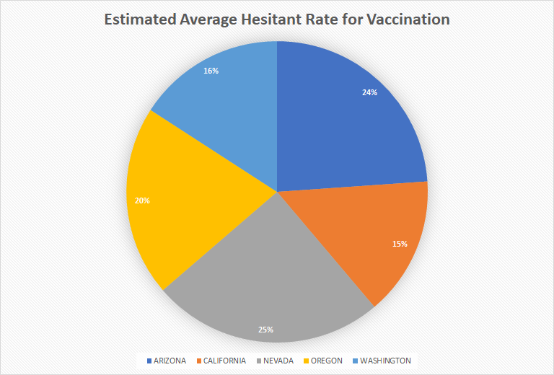
Pie Chart
Notes:
-Kevin

Slide 10
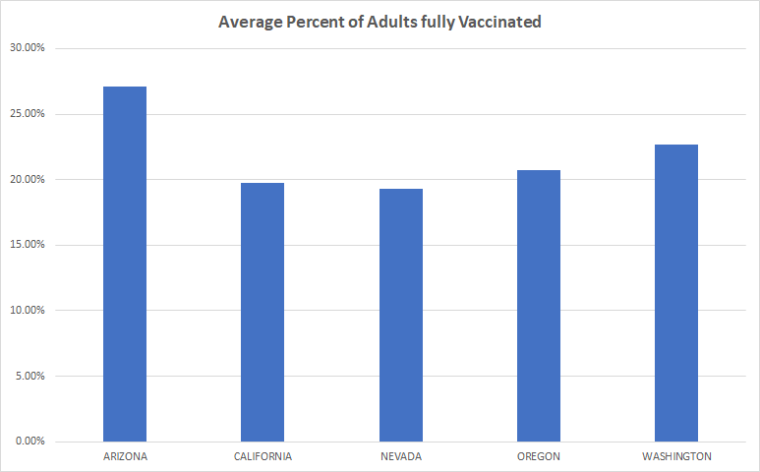
Bar Chart
Notes:
-Kevin

Slide 11
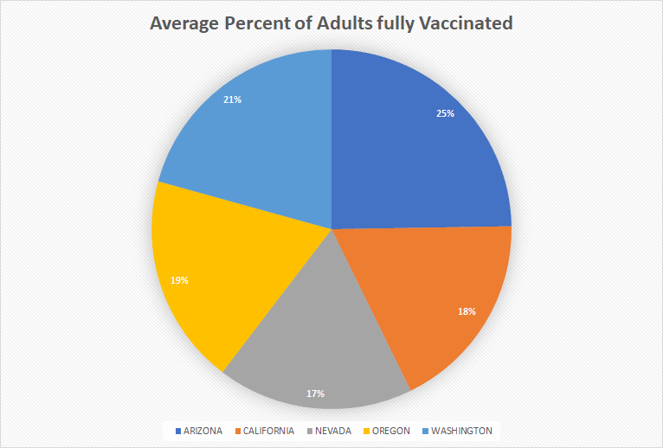
Pie Chart
Notes:
-Kevin

Slide 12
Github URL
https://github.com/jc7mendoza/vaccinedata

